Slide 1
Tira Beauty: Mini Project
Under the Guidance of Vaishali Mam.
Presented By:
B. Anush Kumar

Slide 2
Contents:
Introduction
Overview of Modules Tested
Functionalities Tested
Defects
Challenges & Experience

Slide 3
INTRODUCTION
Tira Beauty is a modern e-commerce platform dedicated to beauty and cosmetic products.
It offers a seamless shopping experience, allowing users to discover, save, and purchase items from a wide range of global and homegrown brands.
Purpose: To automate testcases using Selenium WebDriver and TestNG Framework.

Slide 4
OVERVIEW OF MODULES TESTED
login Module
Functionalities Tested:
Verified login functionalities including OTP verification.

Slide 5
Search Module
Functionalities Tested:
Searching for products by name, brand, and category.
Filtering search results by price, brand, and other attributes.
Verifying the "No results found" message for invalid searches.
Ensuring the search handles special characters.

Slide 6
Add to Cart Module
Functionalities Tested:
Adding single and multiple products to the shopping cart.
Updating the quantity of items in the cart.
Removing items from the cart.
Ensuring the cart total updates correctly.
Verifying that the cart contents remains same after a page refresh/login.

Slide 7
Wishlist Module
Functionalities Tested:
Preventing guest users from adding to the Wishlist (prompting login).
Adding a product to the Wishlist.
Removing an item from the Wishlist.
Moving an item directly from the Wishlist to the shopping cart.
Ensuring the Wishlist is saved to the user's account and after logout/login.

Slide 8
Offers Module
Functionalities Tested:
Verified that offer banners redirect to the correct pages and that promotional codes can be successfully applied in the cart.
Brands Module
Functionalities Tested:
Ensured the A-Z brand list loads correctly and that clicking a brand name properly filters to show only its products.
For You Module
Functionalities Tested:
Verified that product recommendations are personalized for logged-in users based on their browsing and purchase history.

Slide 9
DEFECTS
While running testcases for search module, search results are not accurate, So I created a defect report on those defects

Slide 10
Defect Identifier :- TIRA_SRCH_01
Defect summary: When searching for unrelated items like “car spare parts”, it shows random products results instead of displaying “No Results Found”.
Test Id : TC_001
Test case name : TC_invalidSearchResults
Module name : Search module
Reproducible :
Severity : Medium
Priority : Medium
Raised by : Anush
Assigned to : Development Lead
Date of assignment :
Status : Open
Snap shots :
Fixed by :
Date of fixing :

Slide 11
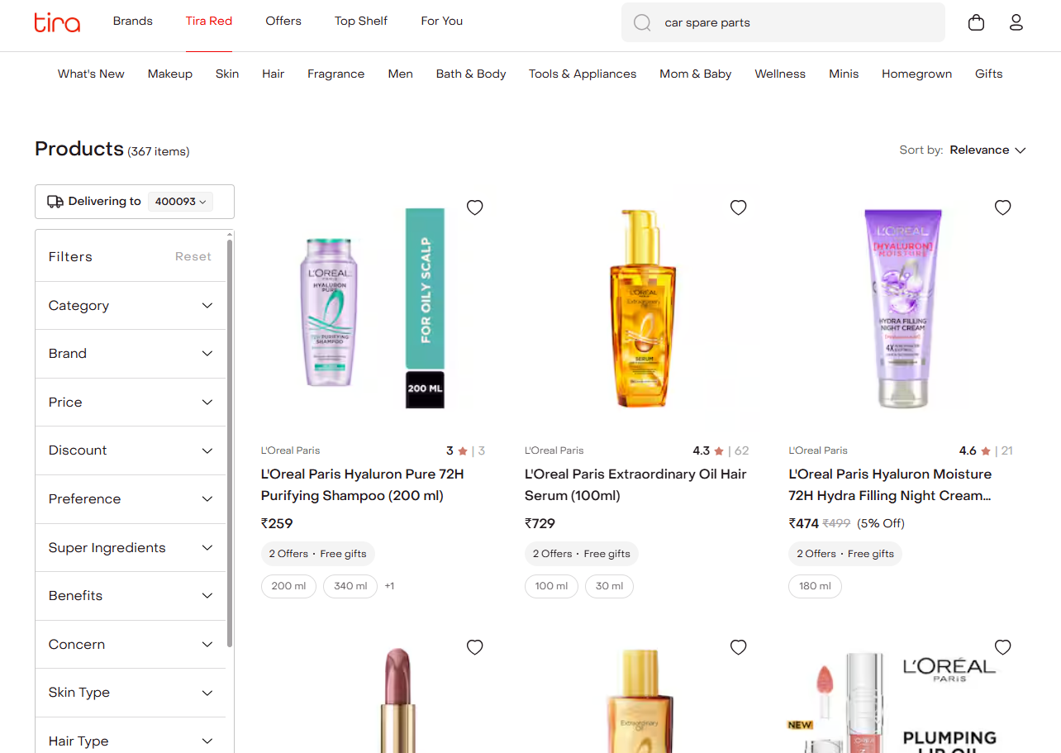

Slide 12
Defect Identifier :- TIRA_SRCH_02
Defect summary: The price filter does not filter products correctly. Searching for “Lipsticks under 500” shows products priced both below and above 500.
Test Id : TC_002
Test case name : TC_incorrect_Results
Module name : Search module
Reproducible :
Severity : Medium
Priority : Low
Raised by : Anush
Assigned to : Development Lead
Date of assignment :
Status : Open
Snap shots :
Fixed by :
Date of fixing :

Slide 13
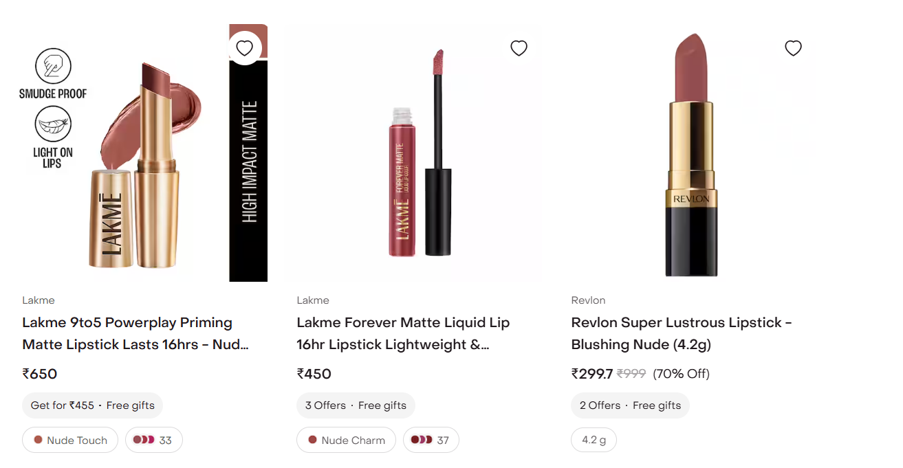

Slide 14
Challenges & Experience
Challenges:
I have ensured test data covered a wide range of products, brands, and prices.
Rechecking defects that only occurred on specific devices or browsers.
Experience:
Handling all modules myself gave me complete end-to-end testing exposure.
Gained experience in automating web applications using Selenium WebDriver and TestNG
In-depth testing helped me uncover critical usability issues.

Slide 15
THANK YOU!

